Slide 1

Evaluation of Various Sensing Modalities for Accurate Measurement of Neck Flexion Angle during Thyroid and Ear Surgery
Team Member : Zhen Hu, Hanqing Duan
Mentor: Dr. Russell Taylor, Dr. Deepa Galaiya

Slide 2
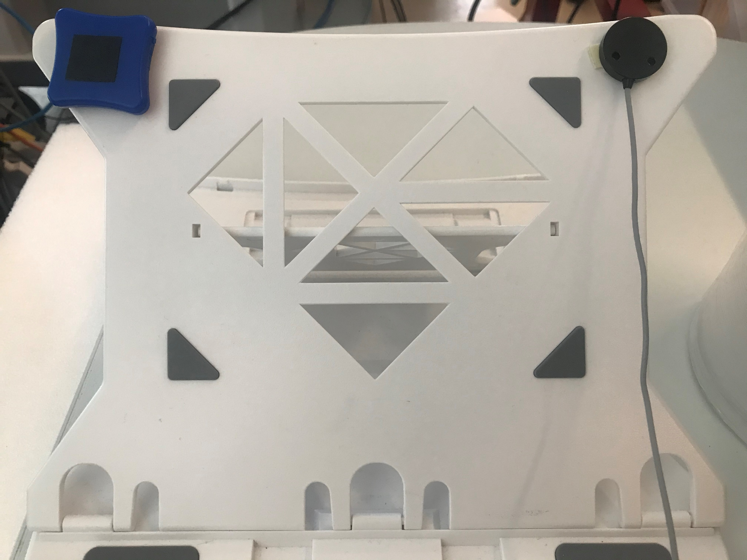
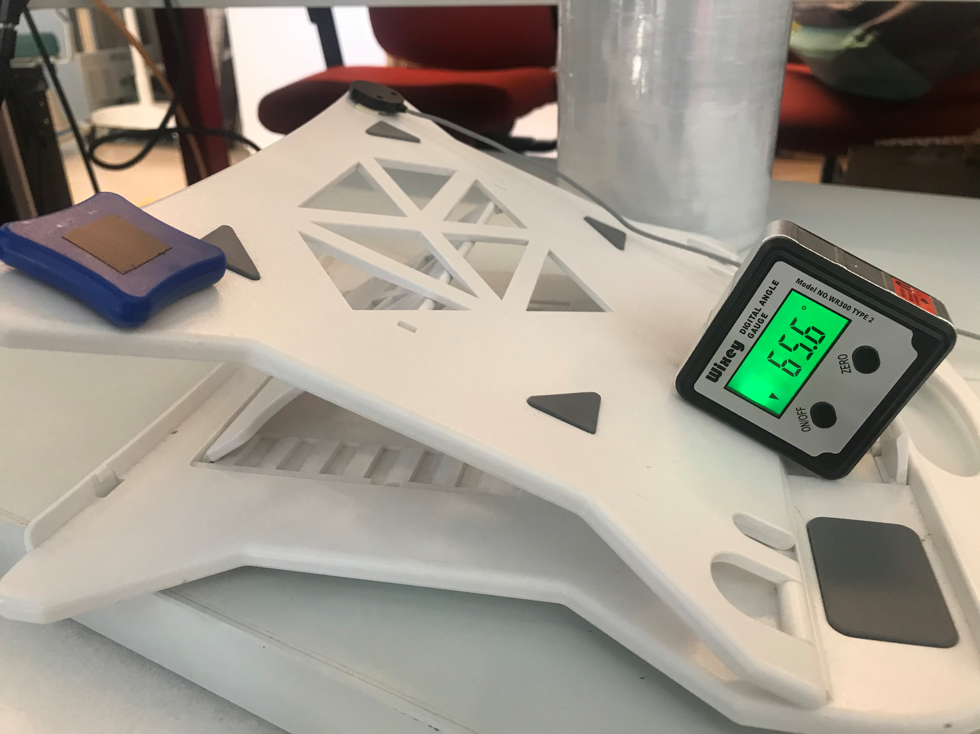
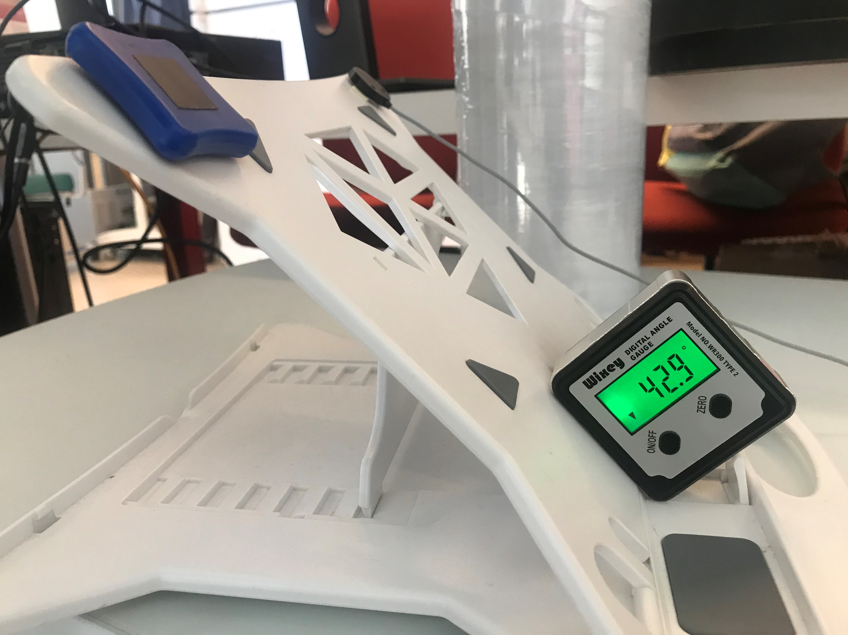
Calibration of IMUs
One IMU vs one EM tracker – ground truth
Use the laptop stand to change angles
IMU and EM tracker can not be banded together because of magnetic field
Stable for a while at 9 different angles
Collect data for both IMU and EM tracker at the same time
Problem: only one rotation axis could be calibrated, but we only care about this one pitch angle. Is this calibration method enough?

Slide 3
Calculate Neck Flexion Angle
Get quaternion from each IMUs (q1 and q2)
Use Quaternion to calculate flexion angle mathematically
z = quatmultiply(quatconj(q1),q2)
a = 2* atan2(norm(z(2:4)),z(1))/pi*180
Next week
Finish calibration
Collect mock surgery data

